Slide 1
STLC - Templates

Slide 2
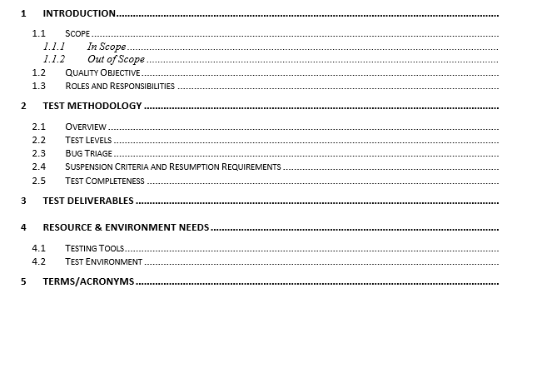
Test Plan

Slide 3
Test Case

Slide 4
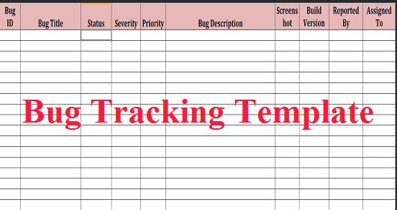
Defect Tracking

Slide 5
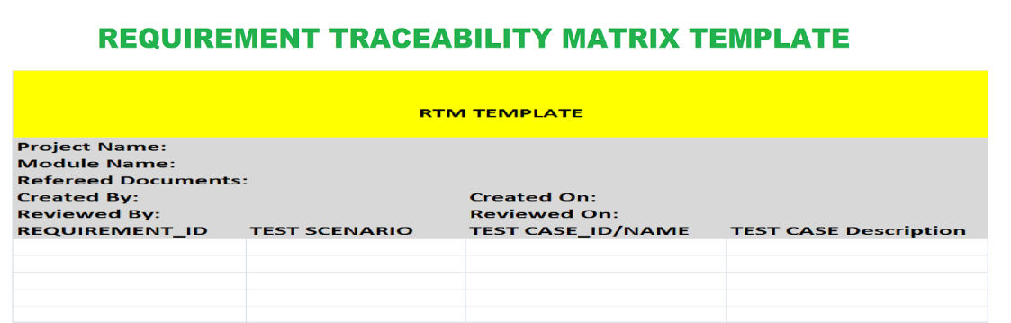
RTM

Slide 6
For more information please contact:
T+ 33 1 98765432
F+ 33 1 88888888
M+ 33 6 44445678
firstname.lastname@atos.net

